Slide 1
Final Software Project: The University Enrollment System
Bill Maggs
The University of Arizona Global Campus
CST499: Capstone for Computer Software Technology
Dr. Charmelia Butler
November 4th, 2024
Notes:
Hi, I’m Bill Maggs, a student at the University of Arizona Global Campus, and this is my presentation for the final capstone software project for CST499

Slide 2
Agenda
Key aspects of the Software Requirements Specification
UML design model and evolution
MySQL Database and class registration.
Design of landing, login, and enrollment pages (demonstration).
Discuss the PHP code that you wrote for this course (selected excerpts).
Notes:
Our agenda today will be covering the key aspects of the software requirements specification or SRS, and coverage and evolution of the UML design models used. It will be useful to first discuss the mysql database with regard to class registration and then the landing, login and enrollment pages. There are 18 webpages defined by 20 PHP scripts utilizing over 1,500 lines of PHP code. In the interest of time, rather than trying to include dozens of screenshots, a brief demonstration will be given, along with an examination of select PHP script highlights. All are available on the git website listed in the references.

Slide 3
Key aspects of the SRS
Why have an SRS? (Perforce, 2023)
The template. (IEEE, 1984)
Requirements:
Functional/System such as registration, login, course listings, course enrollment
Non-Functional such as security, performance, and scalability
External Interface/User Interface through a web interface
Constraints for unique user ID’s, max capacity, courses by semester.
Notes:
Why an SRS –
This provides a clear, agreed-upon understanding of what the software will accomplish. It ensures that the client's expectations are met by documenting all functionalities and constraints. The SRS also serves as a foundation for project planning, design decisions, coding guidelines, and testing strategies. By detailing every aspect of the software, the SRS reduces the likelihood of misunderstandings between stakeholders such as users, developers, and project managers. It helps prevent scope creep by clearly outlining what is included in the project and what is not. As defined by Perforce, “the SRS serves as an action plan for all stages of the project from development to maintenance”. (Perforce, 2023).
Though there are multiple templates available for an SRS, the IEEE IEEE Guide for Software Requirements Specifications from 1984 will be used the template.
The key requirements as given in the assignment can be categorized in the SRS into four categories: Functional Requirements, Non-Functional Requirements, Interface Requirements, and Constraint Requirements. These will be translated into concrete requirements in the respective sections of the SRS, with the following summaries. Other sections considered to be relevant for context of the SRS, primarily sections one and two, will also be maintained.
The Functional Requirements/System Features will consist of a new user registration, including profile information and process for assigning a user ID. There will also be requirements for Login Functionality, Course Listing by Semester, and Course Enrollment options. The system must allow new users to register by creating an account and profile. Each new user must have a unique ID associated with a password. The system must prevent two users from using the same ID during registration. Profiles must include name, phone number, email, and other necessary information such as address and date of birth. Post-registration, users must be able to log in to the system using their unique ID and password. Users must be able to list the courses offered during any of the three semesters (spring, summer, and fall), as not all courses are available in every semester. Each course should have a maximum enrollment capacity that may vary depending on the course. Users must be able to enroll in courses based on availability. If a course is full, users must be able to add themselves to a waiting list. Users must also be able to cancel their enrollment in any course they are registered for.
Non-functional requirements will define security, performance, and scalability. The system must securely manage user accounts and use access controls to prevent unauthorized use. The system must handle high traffic during peak times (such as course registration periods) without significant delays. The system must scale to support thousands of simultaneous users during enrollment periods.
For the External Interface/User Interface requirement, users must interact with the system through an intuitive web interface for actions like registration, course enrollment, and account management.
For Constraints, the system must ensure that all user IDs are unique and cannot be duplicated. Each course must have a predetermined maximum enrollment limit that can vary based on the course. Not all courses will be offered every semester, and this constraint must be considered during course listings and enrollment.
These requirements help ensure that the system is well-organized, meets user needs, and complies with operational constraints.

Slide 4
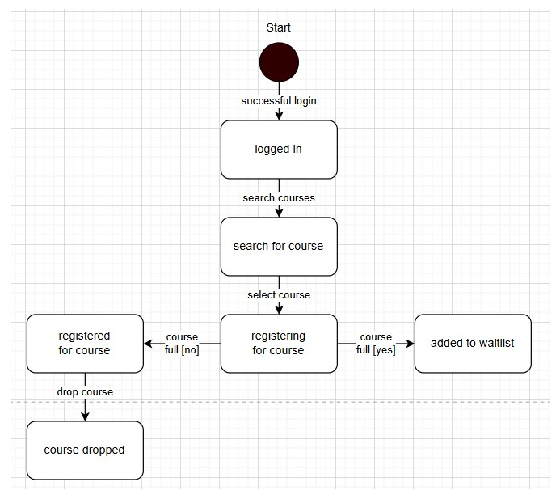
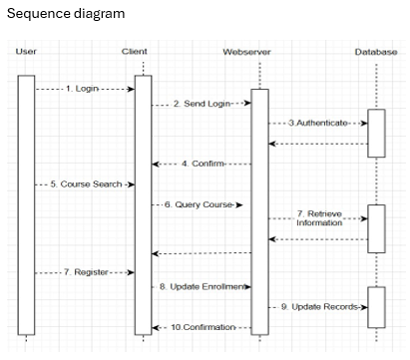
The UML
Initially Six Diagrams in the SRS
Two proved very useful – sequence and state diagrams
Sequence Diagram (Bell, 2023)
State Diagram (Geeks for Geeks, 2024)
Notes:
A Sequence Diagram captures the interaction between different system components during a specific process—in this case, course registration. The primary use is showing the interactions between a user and the system in the order in which they occur and are useful for documentation during the design phase of the developing systems expected behavior and aids in the transition from use case requirements to the next formal level of requirements refinement (Bell, 2023). Not only does this give guidance to the development team, it also aids the business staff in communicating how the system works. Here, it begins with a student logging in and progresses through searching for a course, sending requests to the server, and updating the database when the student registers for a course. This diagram provides a clear view of the step-by-step flow of actions between the User, Client, Web Server, and Database.
The State Diagram captures the various states a Student undergoes when registering for a course. A State Diagram is very useful to the development team, users, and documentation as a behavioral diagram to illustrate the condition of the system at a finite instance in time (Geeks for Geeks, 2024). The diagram uses state transitions to show actions required to move to a different state. These states include logged In, search for courses, registering for course, registered, waitlisted, or dropped. Transitions between these states depend on specific user actions (e.g., logging in, searching for a course, registering) and system responses (e.g., course availability and confirmation on registration).

Slide 5
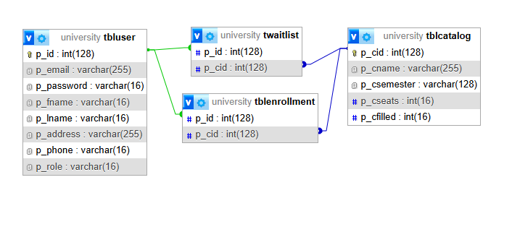
Using phpMyAdmin to Show the mySQL University database Structure

Slide 6
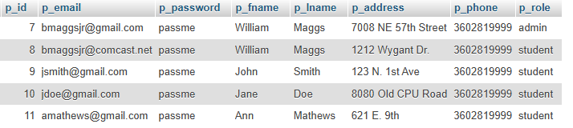
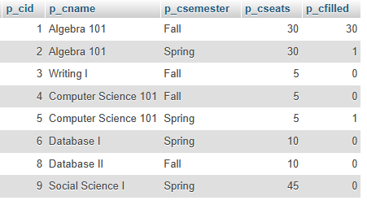


Using phpMyAdmin to Show the mySQL University tables
User Table
Catalog Table
Enrollment
Waitlist

Slide 7
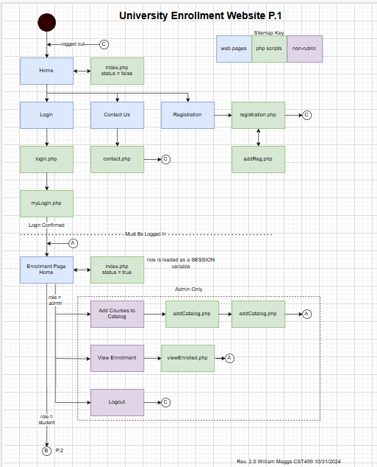
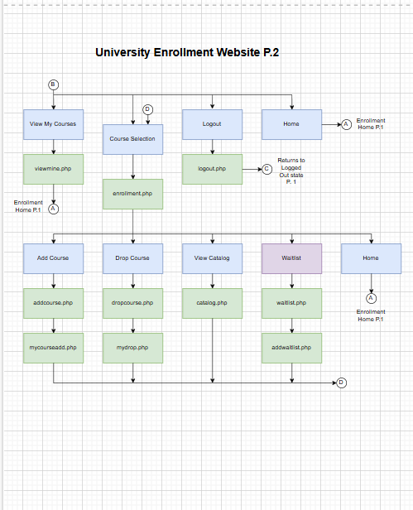
Landing, Login, and Registration Pages
Notes:
As can be seen from the site map evolved from the state diagram, there are many pages and PHP scripts used in the system. Let’s run through a demonstration of the site, showing the most common actions by from the perspective of two roles – a student, and a administrator.

Slide 8
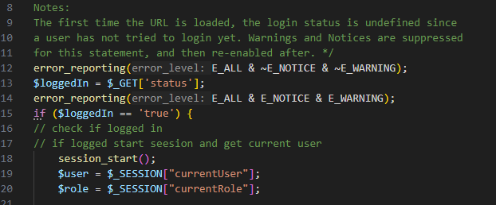
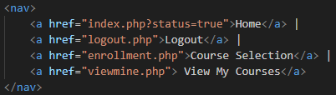
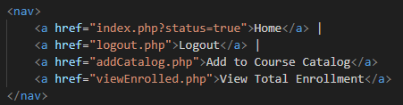
PHP Code
Entry Test
If role == student
If role == admin
Notes:
It is recommended to follow along with a copy of the PHP scripts from github, since the actual code can be somewhat of an eye chart. First to be discussed is the index or main landing page. A couple of key elements here. There are three possible variations in the navigation bar for the landing page. The page attempts to retrieve the superglobal ‘status’. The first time the main landing page is entered, the login status is undefined so warnings and notices are suppressed, and the page will jump to the non-logged in state as shown in the demonstration. If a user or admin has logged in, then the global variable ‘status’ is defined so the index then checks for the role from the session superglobal to give the appropriate navigation links for either student or admin.

Slide 9
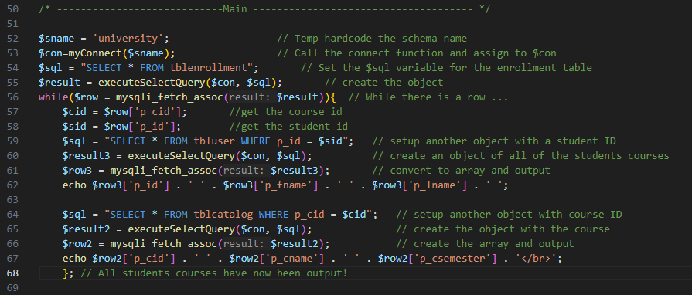
PHP Code
Notes:
The second highlight is showing how an admin can view the total enrollment. A student may view their own courses, but not others. An admin may view the entire enrollment. A user must be logged in with the session superglobal role == admin to reach this script. There are actually three objects created – first, the entire enrollment table with course and student ID. The student ID is then used to pull the student data from the user table, and the course ID is used to pull the associated course information.

Slide 10
Summary
All objectives from the SRS have been met
The UML sequence and flow diagrams became key for development and documentation
Security has been enhanced through access control using roles
Some new techniques were gained for manipulating the databases
Notes:
In summary, this was a great project. All of the objectives from the SRS were met, and though six different types of UML diagrams were investigated it became very apparent that the sequence and flow diagrams were key to keeping the project organized. Though using RBAC was not in the original functional requirement, it really fell into the non-functional requirement for security and evolved into the admin features of adding courses and viewing entire enrollment. And finally, this was great opportunity to dust off some previous PHP and HTML coding skills, and learn some new uses for creating objects. Thank you!

Slide 11
References:
Perforce (2023) How to Write an SRS Document (Software Requirements Specification Document). Perforce. Retrieved from How to Write an SRS (Software Requirements Specification Document) (perforce.com)
IEEE (1984). IEEE Guide for Software Requirements Specifications. IEEE Std 830-1984 , vol., no., pp.1-26, 10 Feb. 1984, doi: 10.1109/IEEESTD.1984.119205.
Bell, D. (2023). Explore the UML Sequence Diagram. IBM Developer. Retrieved from Explore the UML sequence diagram - IBM Developer
Geeks for Geeks (2024). State Machine Diagrams. Geeks for Geeks. Retrieved from State Machine Diagrams | Unified Modeling Language (UML) – GeeksforGeeks
Maggs, B. (2024). CST499 Assignments. Github. Retrieved from bmaggsjr/CST499: GITHUB for CST499 Assignments

